Slide 1


SAP OData Training
Day - 4.

Slide 2


Agenda Day - 4
What is Debugging ?
External Debugger ( Debug using Business User )
What is Association ?
Why we need Association
Benefits of Association
Break
Implementing Association
Association between product and supplier
Sales Order , Sales Order Item – Get Method’s
Association between Sales Order and Order Items
Trainer: Anubhav Oberoy

Slide 3

What is Debugging ?
Debugging is the process of detecting and removing of existing and potential errors (also called as 'bugs') in a software code that can cause it to behave unexpectedly or crash. To prevent incorrect operation of a software or system, debugging is used to find and resolve bugs or defects
The ABAP Debugger is a tool of the ABAP with which you can stop running program und then execute them line-by-line or section-by-section. ... This means any errors in the source text of the program can be found quickly. The ABAP Debugger is an integrated test tool within the ABAP Workbench.
01
02
Trainer: Anubhav Oberoy

Slide 4
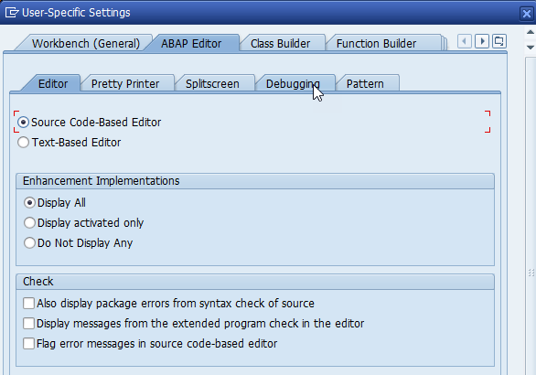
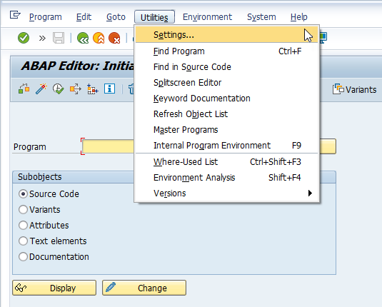
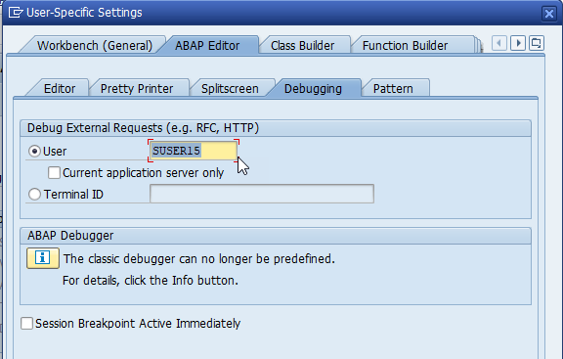
Debug using Business User
Step 1. Go to Tcode SE38
Step 2. Click on Utilities & go to Settings.
Step 3. Click on Debugging & Select User.
Software Innovation
02
Hardware Innovation
Trainer: Anubhav Oberoy

Slide 5
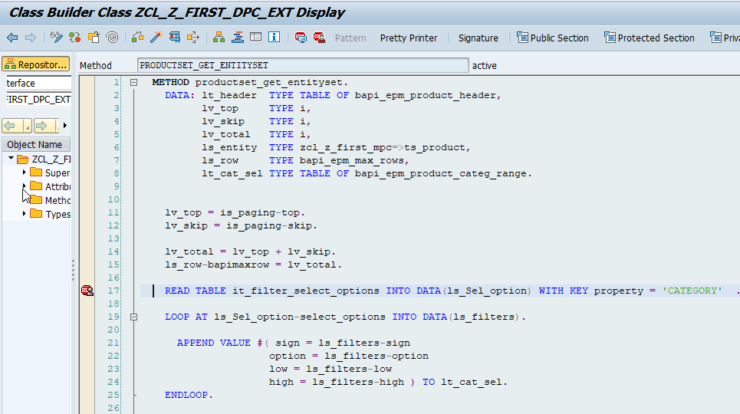
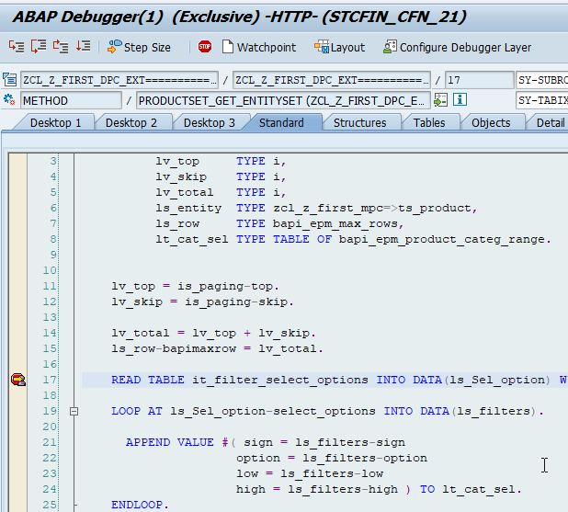
Steps for Perform Debugging
Single step (the F5 key).
Execute (the F6 key).
Return (the F7 key).
Run/Continue (the F8 key).
Introduction
Assign External Debugger
01
Software Innovation
02
Hardware Innovation
Trainer: Anubhav Oberoy

Slide 6
What is Association ?
You can define associations between entities to express relationships between entities. With associations it is possible to reflect foreign key constraints on database tables, hierarchies and other relations between database objects. OSDL( Open Source Development Labs ) supports simple associations, where the information about the relationship is stored in one of the participating entities, and complex associations, where the relationship information is stored in a separate association table.
Associations are relationship Between entities.
At database level we have foreign key relationship and same is reflected at odata level.
Once a association is created only then we can create navigation property.
Trainer: Anubhav Oberoy

Slide 7
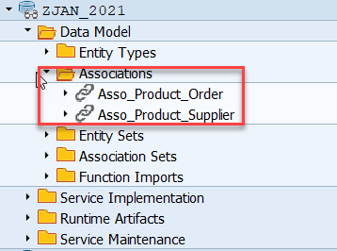
Why we need Association
we understood the basic operation performed in OData service. invoked by $expand. Let's see what is meant by association and navigation property. Associations define the relationship between two or more Entity Types (for example, Employee Works For Department).
Association Between Product and Supplier.
01
Product
Supplier
1 relation 1
01
nav
02
02
Trainer: Anubhav Oberoy

Slide 8

Break

Slide 9
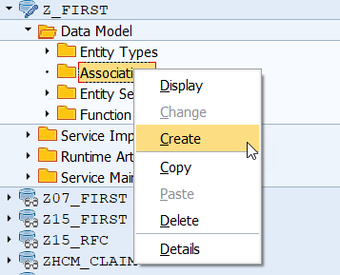
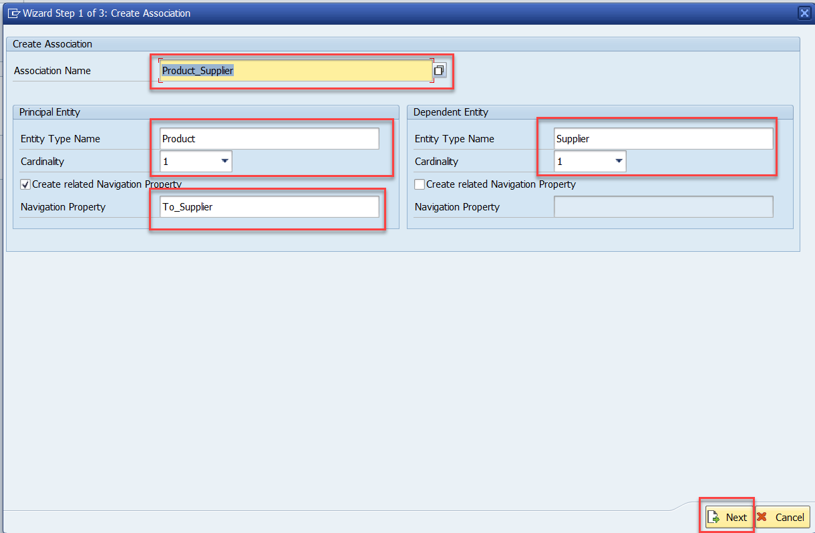
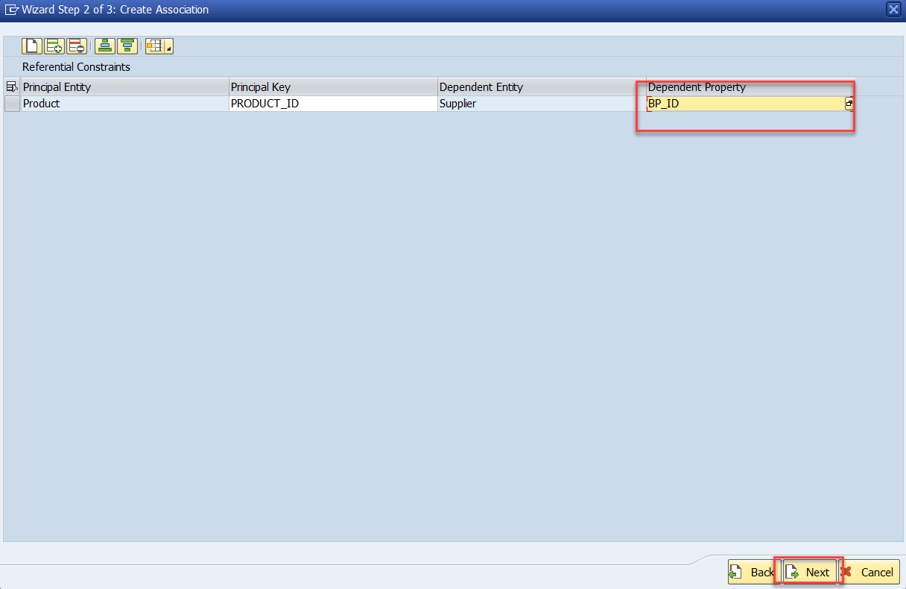
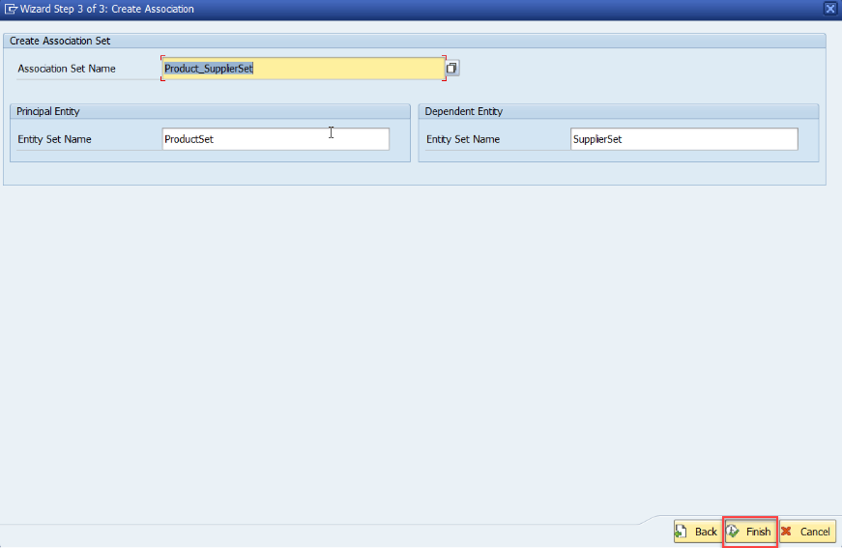
Steps for Creating Association
Step:1 Right Click on Association and click on create
Introduction
01
Software Innovation
02
Hardware Innovation
Trainer: Anubhav Oberoy

Slide 10
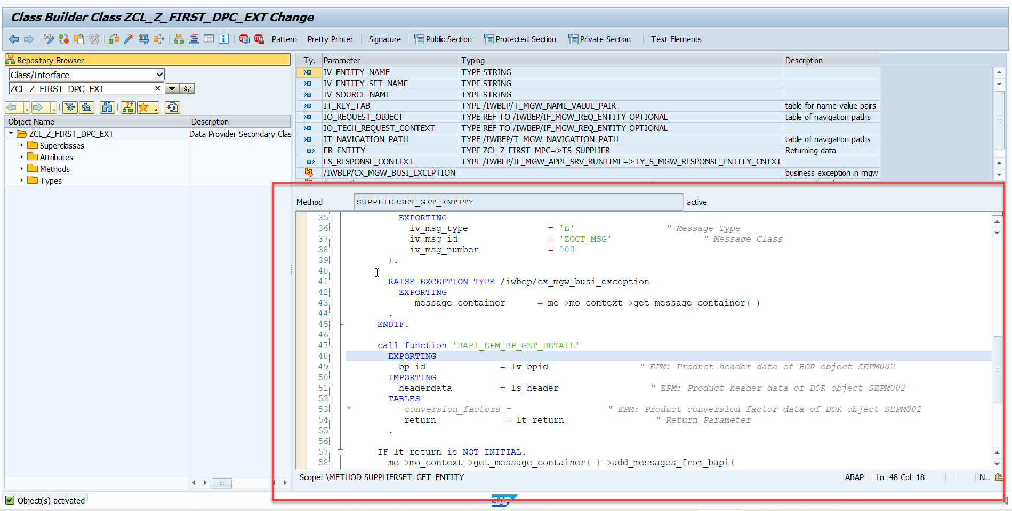
Steps for Creating Association
Step2: Go to DPC extension and redefine the method for supplierSet GetEntity
Introduction
01
Software Innovation
02
Hardware Innovation
Note: Click on the image to get Complete code.
Trainer: Anubhav Oberoy

Slide 11
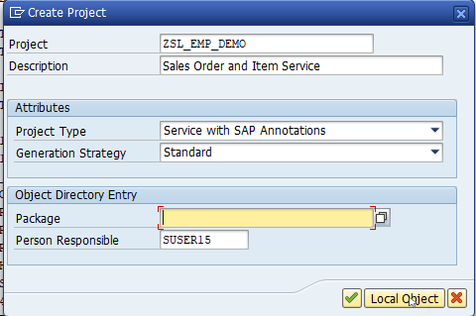
Build OData Service for Sales Order Header And Sales Order Item Data
Introduction
01
Software Innovation
02
Trainer: Anubhav Oberoy

Slide 12
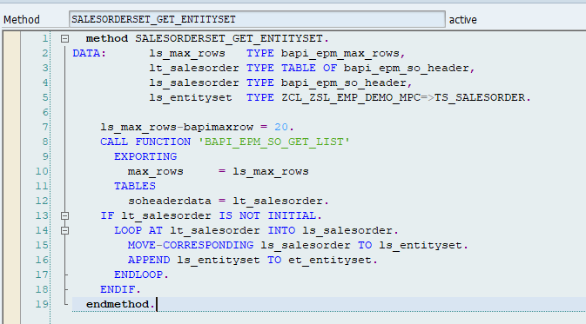
Building Get EntitySet for Sales Order
Go to DPC extension and redefine the method for SalesOrderSet Get EntitySet
Introduction
01
Software Innovation
02
Hardware Innovation
Note: Click on the image to get Complete code.
Trainer: Anubhav Oberoy

Slide 13
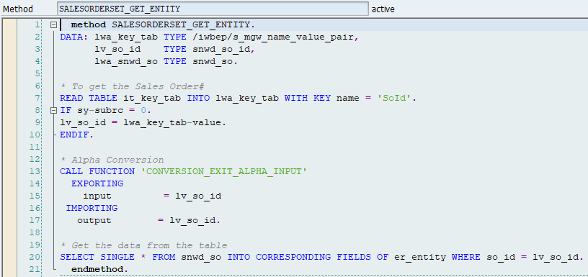
Building Get Entity(Single Record) Method
Go to DPC extension and redefine the method for SalesOrderSet Get Entity
Introduction
01
Software Innovation
02
Hardware Innovation
Note: Click on the image to get Complete code.
Trainer: Anubhav Oberoy

Slide 14
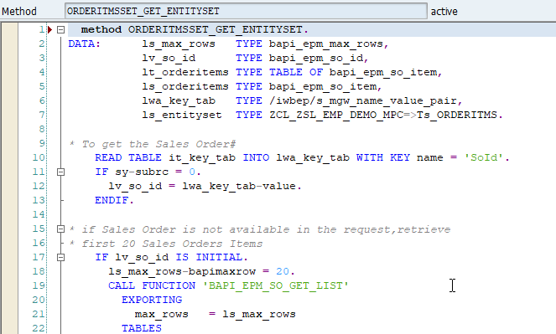
Building Get Entity Set Method for OrderItems
Go to DPC extension and redefine the method for OrderItmsSet Get EntitySet
Introduction
01
Software Innovation
02
Note: Click on the image to get Complete code.
Trainer: Anubhav Oberoy

Slide 15
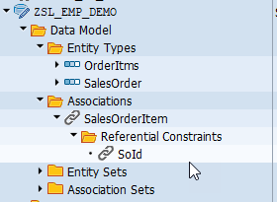
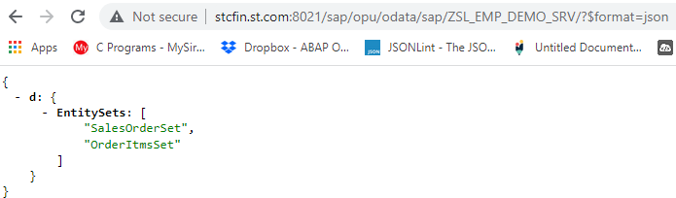
Association Between Sales Order and Sales Order Item
Introduction
01
02
Note: Click on the image for get Service URL.
Trainer: Anubhav Oberoy

Slide 16

Summarize
End of Day 4

Slide 17

Questions

Slide 18

ANUBHAV OBEROY
www.anubhavtrainings.com
THANK YOU
“You can never leave footprints that last if you are always walking on tiptoe.”
Notes:
https://pixabay.com/photos/men-employees-suit-work-greeting-1979261/

Slide 19


We’re committed to empower you to be
Most Desirable Resource
through powerful training solutions.
We build the workforce of the future.
250+
Corporate Clients
30,000+
Learners Trained
25000+
Learners Placed
FREE WEBINARS
Sign up for free webinars with industry experts every fortnight!
Enroll Now!
Contact us today!
https://anubhavtrainings.com/

Slide 20




More from AnubhavTrainings.com

